Slide 1

Exploratory Data Analysis
- with STATA practice
Xian Zhang

Slide 2
Never never never jump to the model you build

Slide 3
Context
1. Goal of Exploratory Data Analysis
2. Exploratory Data Analysis by number of variables
3. Practice in Stata

Slide 4

Goal of Exploratory Data Analysis

Slide 5
Goal of Exploratory Data Analysis
Originally defined by John W. Tukey, mathematician and inventor of the box plot and 5-number summary：
“Exploratory data analysis isolates patterns and features of the data and reveals these forcefully to the analyst. Exploratory data analysis ... does not need probability, significance, or confidence.”
“Exploratory data analysis is an attitude, a state of flexibility, a willingness to look for those things that we believe are not there, as well as those we believe to be there.”

Slide 6
Goal of Exploratory Data Analysis
Understand the patterns and features of your data
Clarify your story for your audience and build trust with your audience

Slide 7
Exploratory Data Analysis by number of variables

Slide 8
Exploratory Data Analysis by number of variables
Univariable: logic check, missing, outlier
Bivariable: unadjusted results between exposure (X) and outcome (Y)
*Tri-variable: confounders, stratified analyses (Z)
Table 1 Descriptive analyses
Basic model: the first regression
Multivariable modelling, Stratification analyses

Slide 9
Univariable: variable types
1. Discrete variable: racial/ethnic group, sex, education level, marriage status, NCD status
It could be further divided into two types: nominal (unordered) and ordinal ordered).
2. Continuous variable: age, height, weight, blood pressure, measures, BMI
3. Turn continuous variables into discrete variable

Slide 10
Univariable: Discrete variable
Frequency statistics are the main descriptive statistics used with discrete variables. These include absolute frequencies (raw counts) for each category of the discrete variable, relative frequencies (proportions or percentages of the total number of observations), and cumulative frequencies for successive categories of ordinal variables.

Slide 11
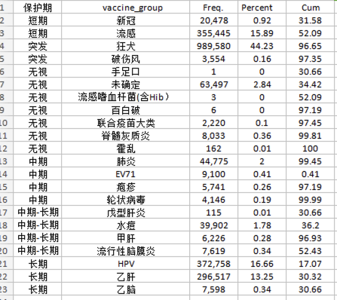
Observe pattern from frequency

Slide 12
Univariable: Continuous variable
Location statistics: mean, median, mode, quantiles
Dispersion statistics: variance, standard deviation, range, interquartile range
Shape statistics: skewness, kurtosis
* geographic distribution and time trend
Logic check
Outlier
Model assumption check

Slide 13
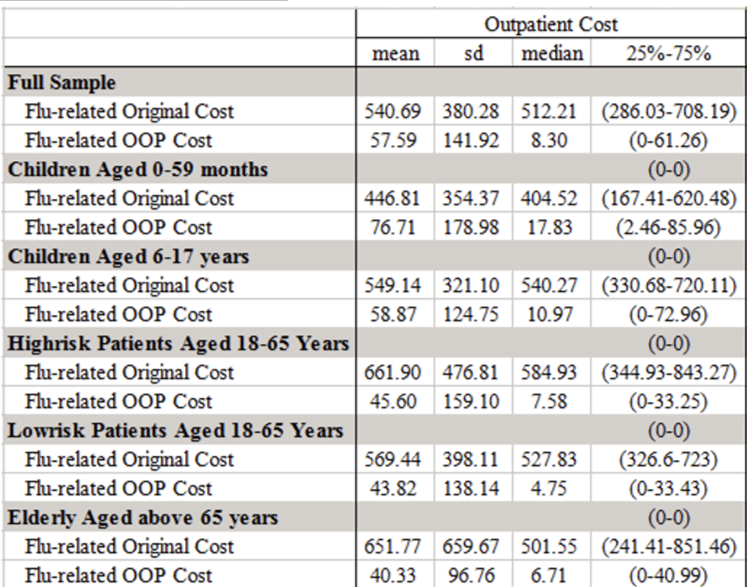
Location statistics & Dispersion statistics

Slide 14
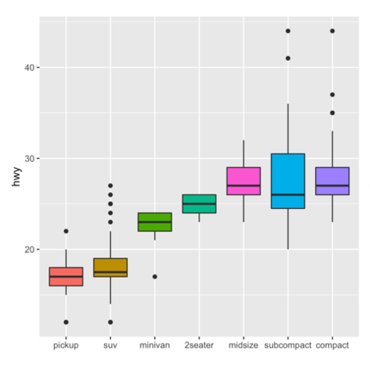
Location statistics & Dispersion statistics

Slide 15
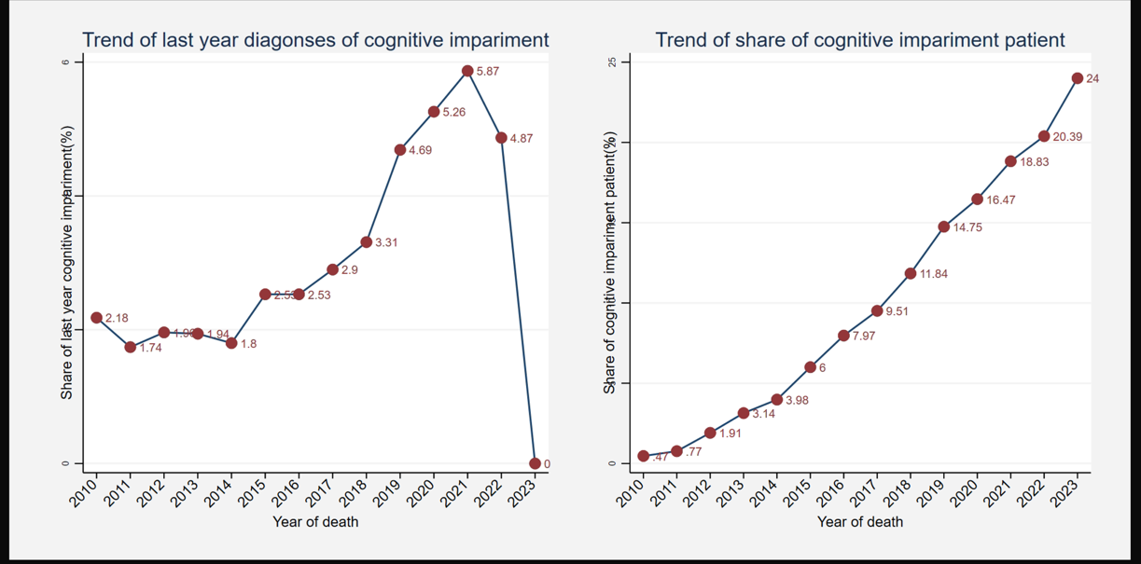
Location statistics & Dispersion statistics

Slide 16
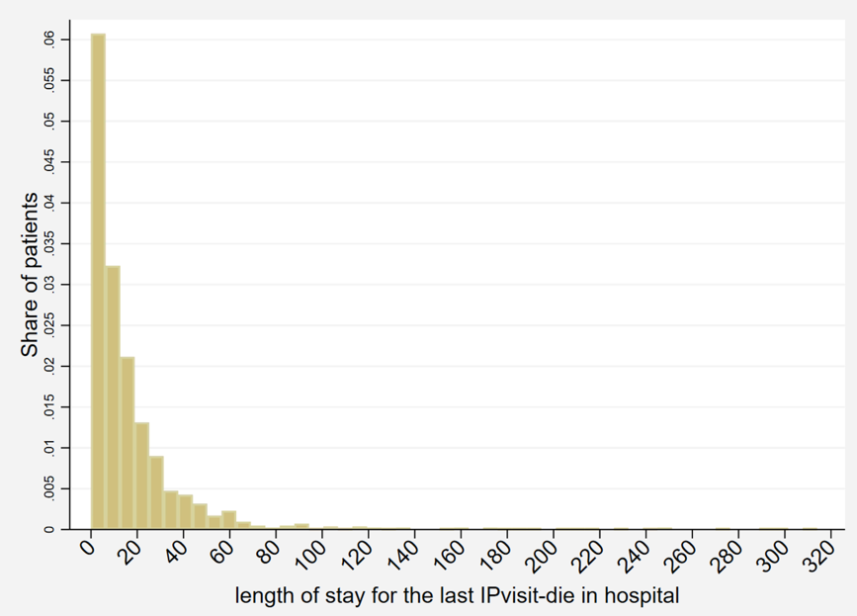
Shape statistics: skewness, kurtosis

Slide 17
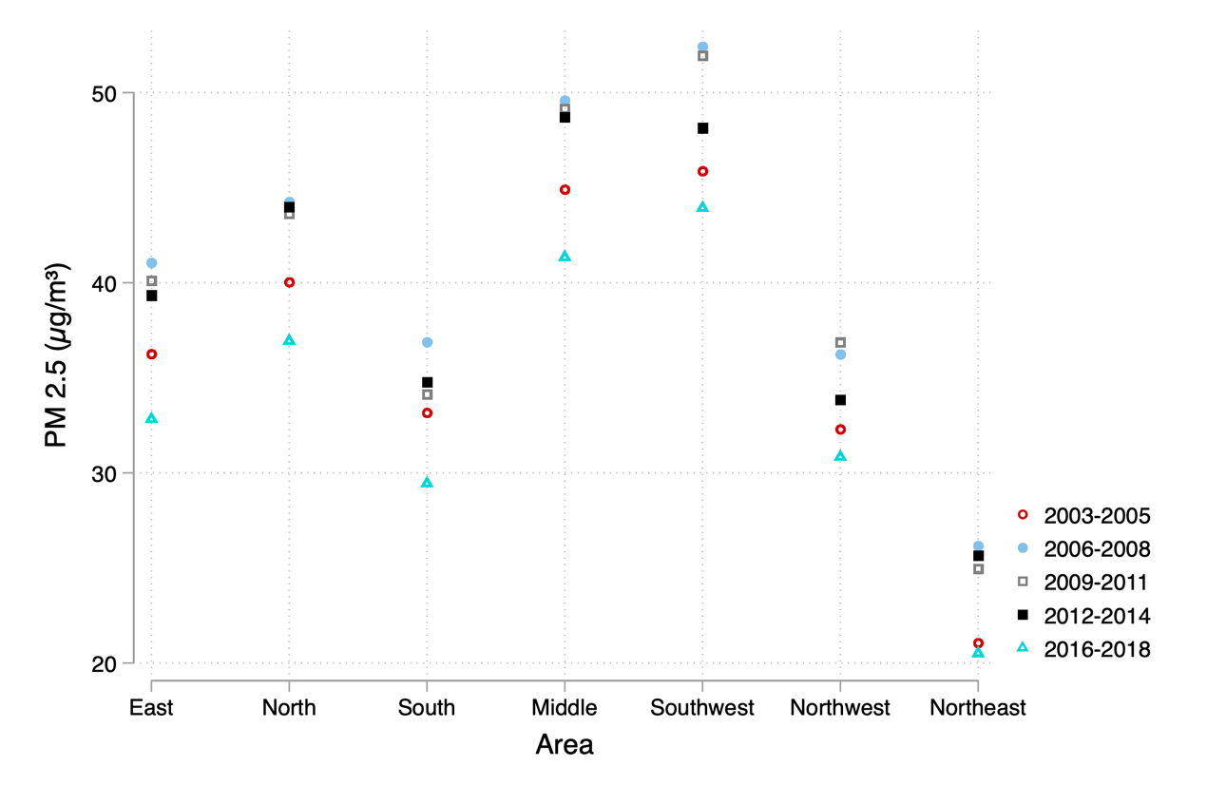
Geographic distribution and time trend

Slide 18
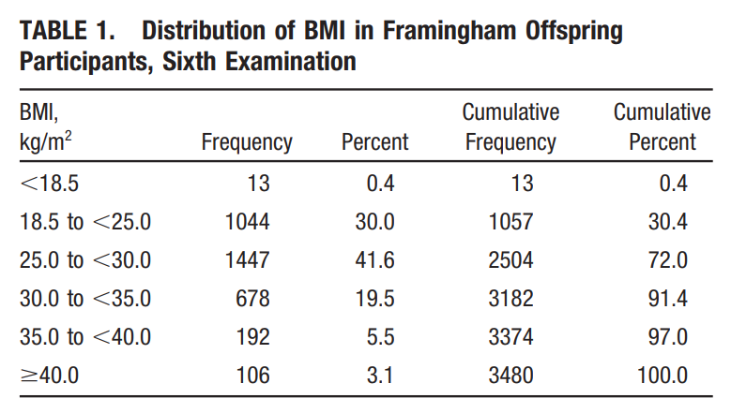
Univariable: Turn continuous variables into discrete variable

Slide 19
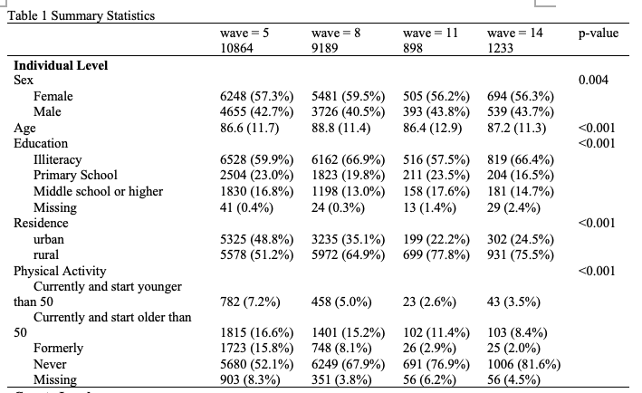
Univariable: report descriptive analyese (Table 1)

Slide 20
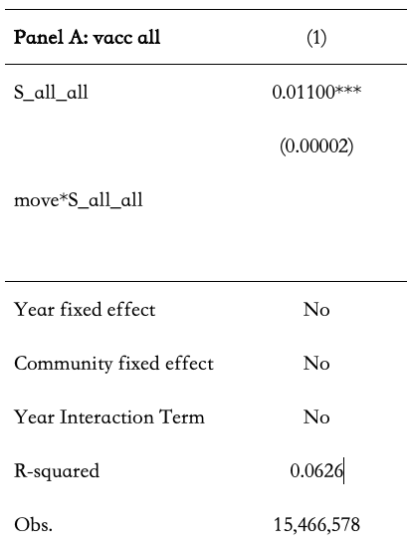
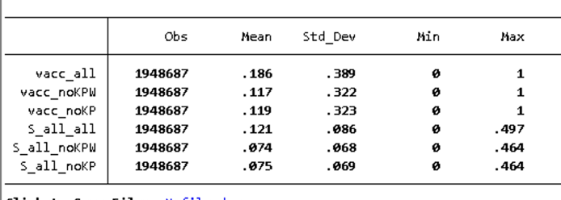
Bivariable: X & Y (the first regression)

Slide 21
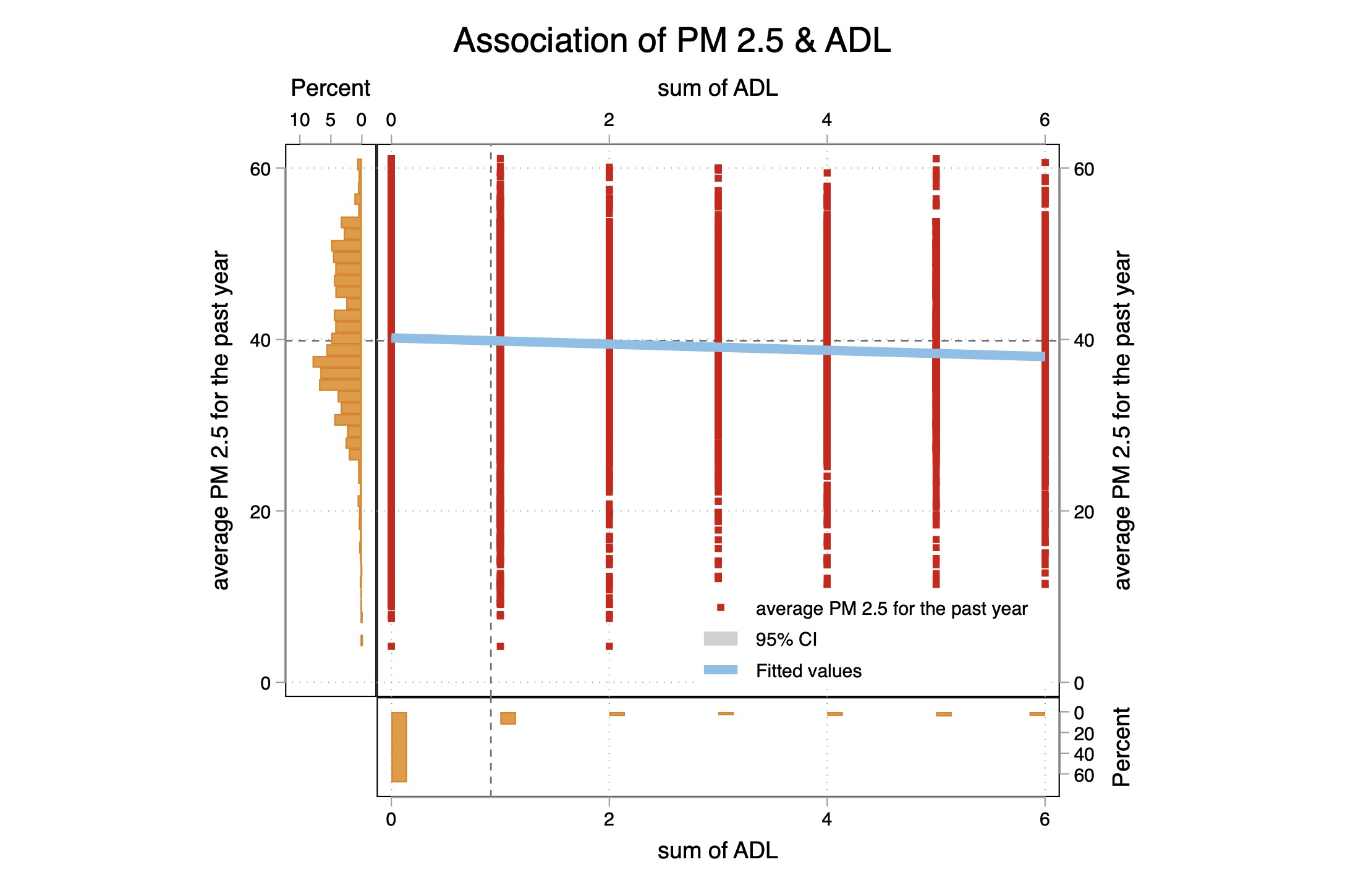
Bivariable: X & Y

Slide 22
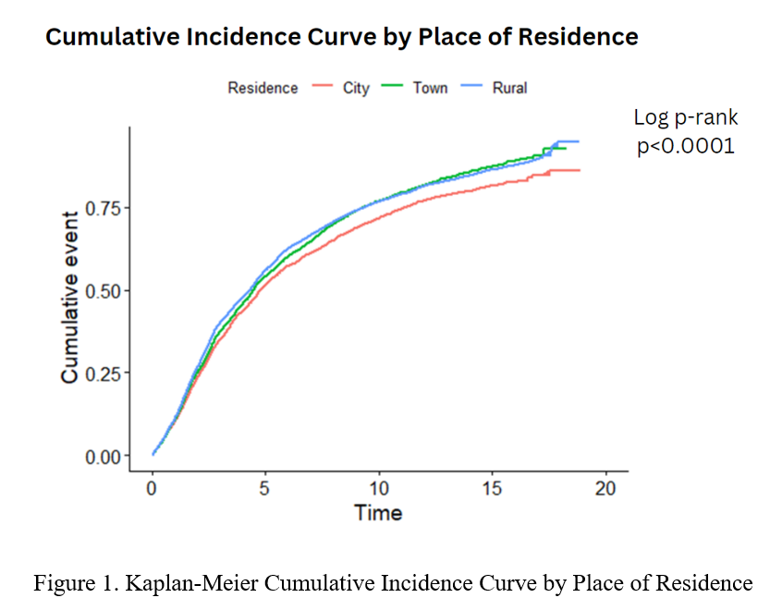
Bivariable: X & Y in survival analyses

Slide 23
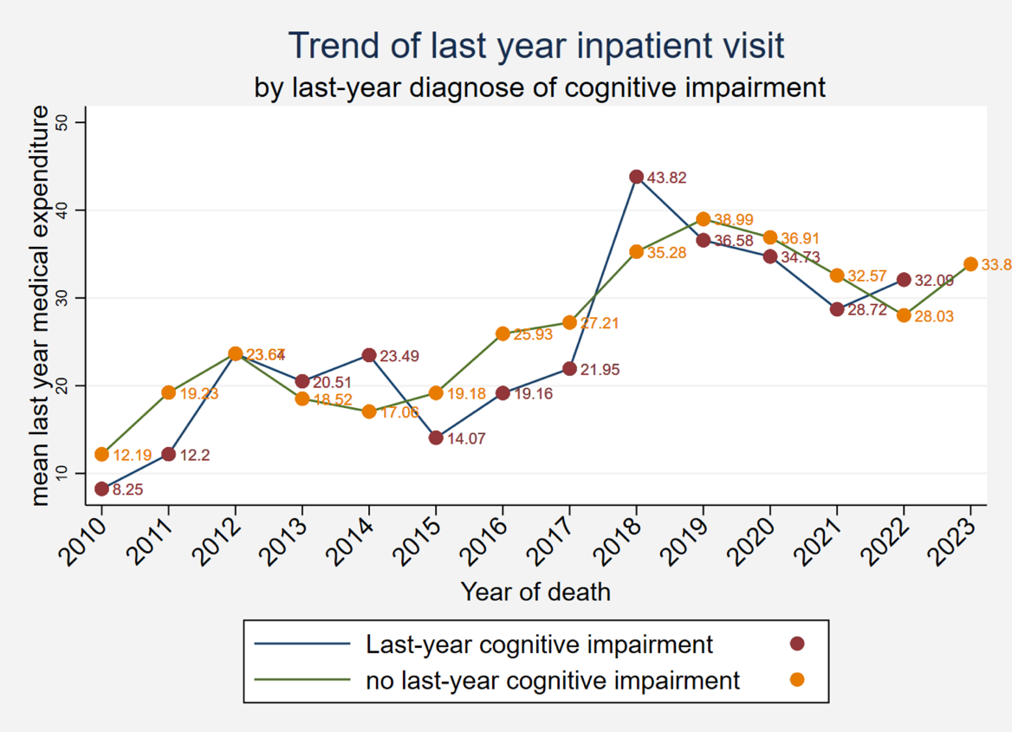
Bivariable: X & Y with time trend

Slide 24
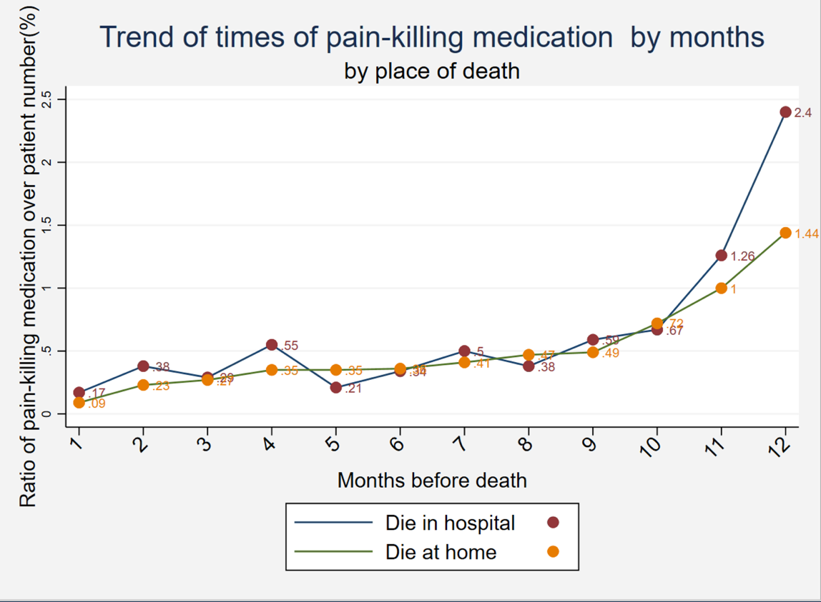
Bivariable: Z & Y & Tri-variable: Y on X by Z

Slide 25
Practice in Stata

Slide 26
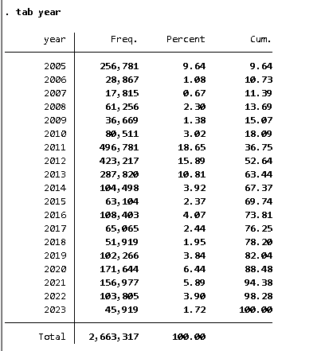
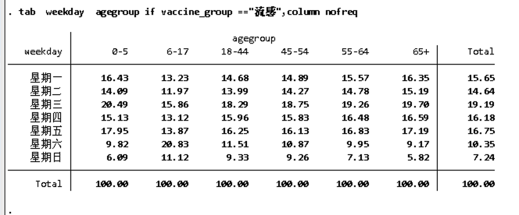
Univariable in Stata: frequency
Tab

Slide 27
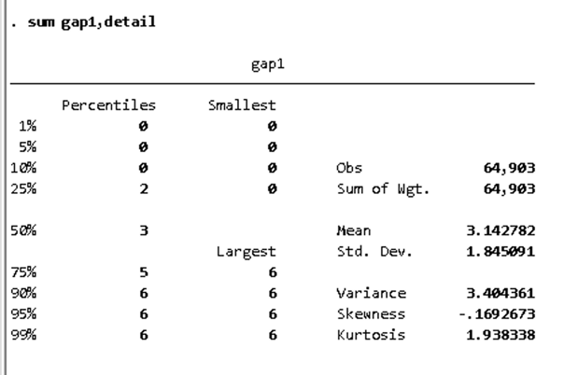
Univariable in Stata: Location statistics and Dispersion statistics

Slide 28
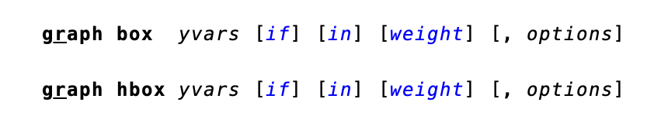
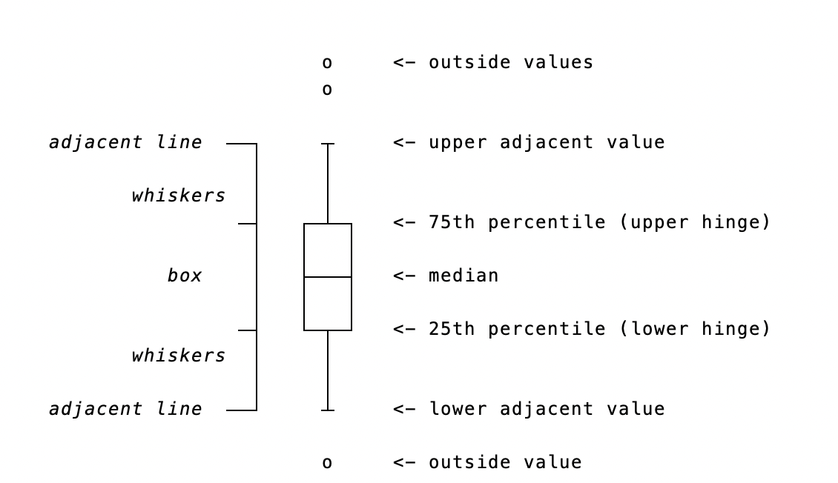
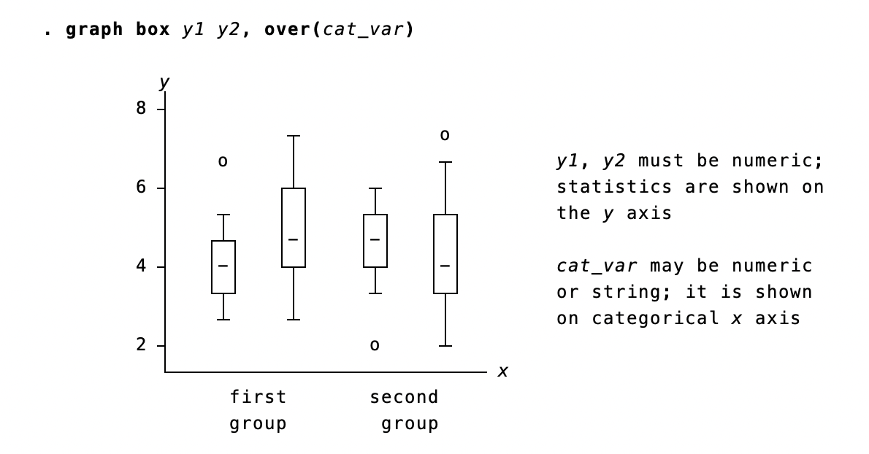
Univariable in Stata: box

Slide 29
Univariable in Stata: Shape statistics

Slide 30
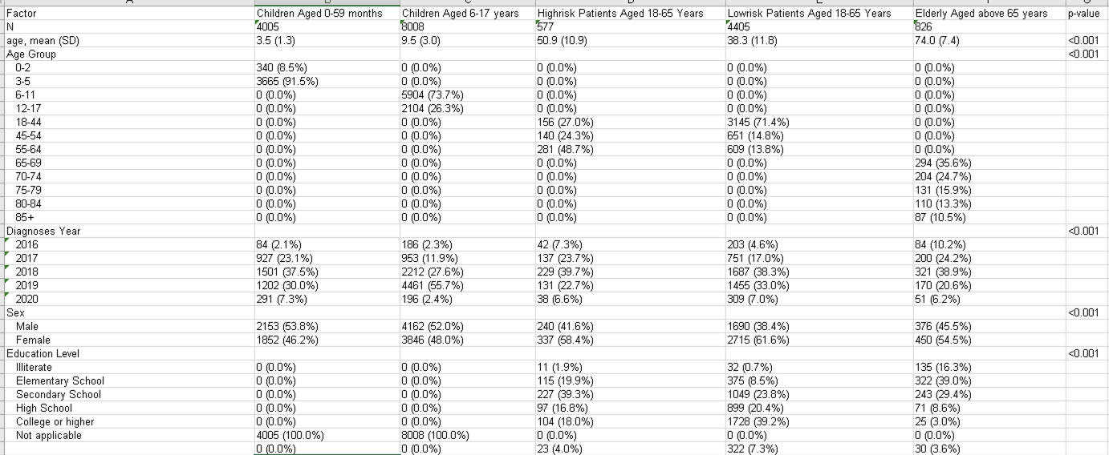
Univariable in Stata: Table 1
https://www.lianxh.cn/news/7ca2b65c68835.html

Slide 31
Bivariable in Stata: Y & X

Slide 32
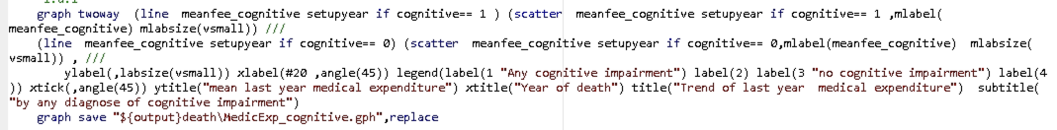
Bivariable in Stata: X & Y with time trend

Slide 33
Resources
连玉君： https://www.lianxh.cn/news/7ca2b65c68835.html
Komorowski M, Marshall DC, Salciccioli JD, et al. Exploratory Data Analysis. 2016 Sep 10. In: Secondary Analysis of Electronic Health Records [Internet]. Cham (CH): Springer; 2016. Chapter 15.

